Slide 1
Neural Networks and Fuzzy Control(ECE3009)
Project Title:
“VEHICLE DETECTION BY USING VEHICLE ENGINE SOUND”

Slide 2
GROUP MEMBERS
Vishakha Kumar – 17BEC0673
Mishu Dave – 17BEC0835
Diksha Raghunathan – 17BMD0068
Jevetha Vijayadasan – 17BMD0073

Slide 3
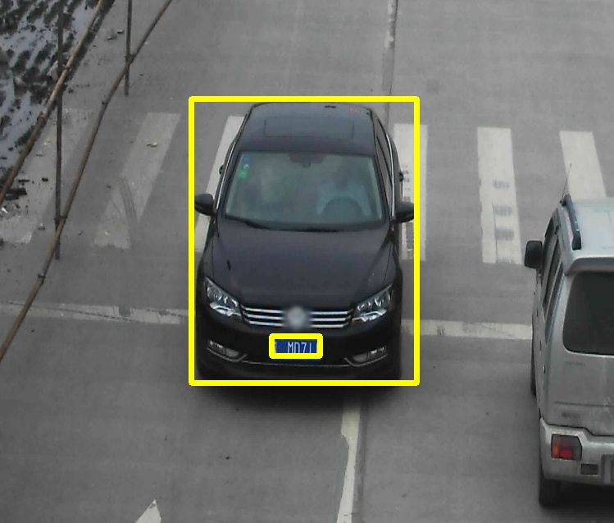
ABSTRACT
This project aims for detection/classification of cars of different companies/models using 2 layered neural network with back propagation algorithm. Different cars engine sounds will be having different frequencies, this property is utilized for car classification.

Slide 4
INTRODUCTION
1.Data collection:
To collect 7 different car engine sounds using mobile microphone.
To scan for car engine sound
2.Data pre processing.
The car sounds .mp3 file are read into matlab using audioread command.
Then we have to divide each type of car engine sound into 5s , so that we will get 10 training car sound for each type.
Then we have to apply fast fourier transform to all trainings engine sounds to get the frequencies of engine sound.
Then we normalize the signal after fft.
And then we have to take absolute value.

Slide 5
METHODOLOGY
Neural Network for classification
The car data X is fed into the neural network,
Our neural network is made up of two layers,
1 hidden and 1 output layer.
Hidden layer consists of 2 neuron. Output layer consists of 7 neurons.
Tanh activation function is used.
Our aim is to get output equal to target.
Using back propagation algorithm all weights and bias are updated.

Slide 6
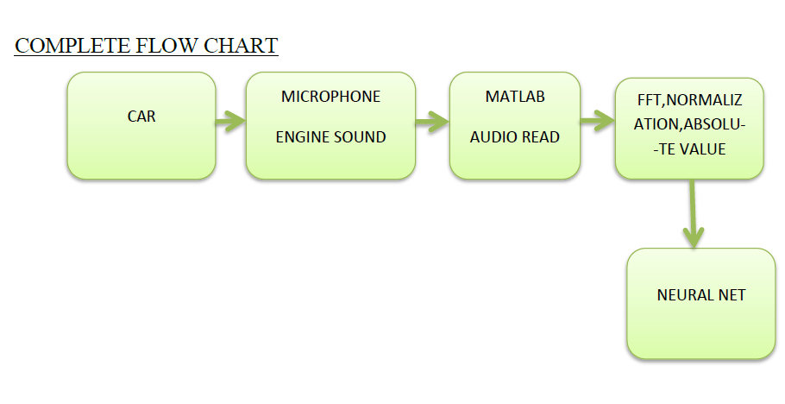
FLOWCHART

Slide 7
LITERATURE SURVEY
Paper 1:
When a vehicle passes the microphone the recorded acoustic signal shows a peak in energy. The energy contour is smoothed and peaks are automatically located for detection of vehicle sound signal. Mel frequency cepstral coefficients are extracted for detection the regions around detected peaks. The feature vectors are used for training ANN/KNN classifiers.
Paper 2:
Sound emitted by vehicles are captured for a two lane undivided road carrying moderate traffic. Simultaneous arrival of different types vehicles, overtaking at the study location, sound of horns, continuous high energy noises on the back ground are the different challenges encountered in the data collection. Different features were explored out of which smoothed log energy was found to be useful for automatic vehicle detection by locating peaks. Mel-frequency ceptral coefficients extracted from fixed regions around the detected peaks along with the manual vehicle labels are utilised to train an Artificial Neural Network (ANN)

Slide 8
Paper 3:
An investigation of acoustic features relating to vehicular traffic on roadways is reported. Computable features that relate to the type of vehicle and state of motion can be useful in monitoring traffic congestion. In the present work, different vehicles, broadly classified into two, three wheelers and heavy vehicle, are studied for their acoustic signatures. A source filter model of engine sound is used to derive suitable features. The performance of formant based features is compared with that of Mel-frequency cepstral coefficients (MFCC) via a k-NN classifier on a manually labelled database of traffic sounds.

Slide 9
REFERENCES
George, Jobin & Mary, Leena & S., Riyas. (2013). Vehicle Detection and Classification From Acoustic Signal Using ANN and KNN. 2013 International Conference on Control Communication and Computing, ICCC 2013. 10.1109/ICCC.2013.6731694.
George, Jobin & Cyril, Anila & Koshy, Bino & Mary, Leena. (2013). Exploring Sound Signature for Vehicle Detection and Classification Using ANN. International Journal on Soft Computing. 4. 10.5121/ijsc.2013.4203.
Nikhil Bhave and Preeti Rao.(2011) Vehicle engine sound analysis applied to traffic congestion estimation. CMMR/FRSM.

Slide 10
Thank You!

